Slide 1


MEDICAL DATA OVERVIEW
Exploring Healthcare Data: Insights from Exploratory Data Analysis and Predictive Modeling for ENHANCED PATIENT CARE
Analysis by Tendai Milicent Jonhasi

Slide 2
TABLE OF CONTENTS
1
Executive Summary
2
Project Overview
3
Scope and Methodology
4
Insights from Analysis
5
Recommendations
6
Annexures - Portfolio

Slide 3

EXECUTIVE SUMMARY
The project focuses on leveraging advanced data analytics to enhance healthcare outcomes by analyzing a comprehensive dataset comprising patient records, medical conditions, procedures, medications, and health observations. Its aim is to empower healthcare organizations with actionable insights derived from data-driven approaches, enabling informed decision-making and fostering a culture of continuous improvement in patient care. The integration of predictive analytics with interactive visualization tools supports evidence-based healthcare strategies aimed at enhancing overall patient well-being and quality of life.
We conducted thorough data exploration to understand the structure and quality of the dataset. This involved identifying missing values, outliers, and inconsistencies which were addressed through data cleaning processes.
Through EDA, we uncovered key insights into disease prevalence, patient demographics, medication usage patterns, and health monitoring trends. This analysis provided valuable context for understanding the healthcare landscape within the dataset.
Our project developed predictive models to estimate Quality Adjusted Life Years (QALY) based on health observations. By leveraging machine learning techniques, we aimed to identify factors influencing patient quality of life and provide actionable insights for enhanced patient care.
We integrated our analytical findings into a Power BI dashboard, enabling healthcare stakeholders to interactively explore patient profiles, visualize health metrics, and monitor key performance indicators (KPIs) related to patient care and outcomes.
Key Findings and Recommendations:
Our analysis revealed significant insights into disease prevalence, medication effectiveness, and patient risk profiling. Based on these findings, we recommend personalized care interventions, optimized resource allocation, and targeted health interventions to improve patient outcomes and healthcare delivery.
In summary, our project empowers healthcare organizations with actionable insights derived from data-driven approaches, enabling informed decision-making and fostering a culture of continuous improvement in patient care and population health management. The integration of predictive analytics with interactive visualization tools supports evidence-based healthcare strategies aimed at enhancing overall patient well-being and quality of life.
1

Slide 4

Project Overview
This data was generated using Synthea, a synthetic patient generator that models the medical history of synthetic patients. Their mission is to output high-quality synthetic, realistic but not real, patient data and associated health records covering every aspect of healthcare. The resulting data is free from cost, privacy, and security restrictions, enabling research with Health IT data that is otherwise legally or practically unavailable.
Dataset
DATABASE
TOOLS FOR ANALYSIS
1
2
The Database contains several tables detailed below:
Patients: Contains demographic information such as age, gender, and vital dates like birthdate and deathdate.
Conditions: Describes various medical conditions diagnosed in patients over time.
Medications: Lists medications prescribed to patients along with associated details like reason for prescription.
Observations: Captures different health observations including body metrics (BMI, weight, height), allergies, and immunizations.
Procedures: Records medical procedures performed on patients with reasons and descriptions.
Allergies: Contains all allergies that patients have recorded
Careplans, Claims and other medical-related data
Data Exploration and Cleansing:
MySQL - Used SQL queries to extract and explore data from relational databases
Exploratory Data Analysis (EDA):
Python (Pandas, NumPy) - Utilized Pandas for data manipulation and preprocessing tasks
Visualization Libraries (Matplotlib, Seaborn)
Predictive Modeling:
Python (Scikit-Learn) - Implemented machine learning algorithms for predictive modeling (e.g., linear regression, decision tree, random forest) to estimate QALY based on health observations.
Dashboard Development
Power BI - Developed interactive dashboards using Power BI to visualize key insights derived from data exploration
Integrated SQL queries and Python scripts within Power BI to dynamically connect to the database and apply predictive models
2

Slide 5







SCOPE AND METHODOLOGY
Understanding Disease Prevalence: Identify the most prevalent medical conditions within the patient population to prioritize resource allocation and targeted interventions.
Predictive and Prescriptive Analytics
Quality of Life Assessment: Build predictive models to estimate Quality Adjusted Life Years (QALY) based on health observations and identify factors influencing patient quality of life.
Patient Risk Profiling: Develop profiles of patients at higher risk based on their demographic information, medical history, and health metrics to enable proactive care management.
Exploratory and Descriptive Analytics
Clinical Decision Support: Provide actionable insights to healthcare providers to support clinical decision-making and enhance personalized care delivery.
Health Monitoring Trends: Analyze trends in key health metrics such as BMI, weight, and height to monitor population health and identify areas of concern
Optimizing Healthcare Resource Allocation: Inform resource allocation strategies based on prevalent conditions, patient demographics, and healthcare utilization patterns.
Medication Effectiveness: Evaluate the effectiveness of medications in managing specific health conditions and their impact on patient outcomes.
3

Slide 6

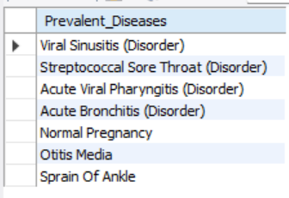
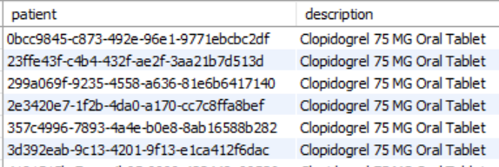
INSIGHTS FROM EXPLORATORY AND DESCRIPTIVE ANALYTICS
While we uncover various insights from the data (see all sql queries), we will focus our attention on the following:
1. Show all prevalent disorders/diseases that have an occurrence of over 30% or 300 in the population that do not have the word Mg in the middle or the end
2. Retrieve all patients that suffered a stroke and where given Clopidogrel 75 MG Oral Tablet?
SELECT medications.patient, medications.description, medications.reasondescription FROM medications WHERE medications.reasondescription = "Stroke" AND medications.description = "Clopidogrel 75 MG Oral Tablet" ORDER BY medications.patient;
SELECT DISTINCT item AS Prevalent_Diseases FROM all_prevalences WHERE all_prevalences.occurrences > 300 AND item NOT LIKE '% Mg%';
4

Slide 7
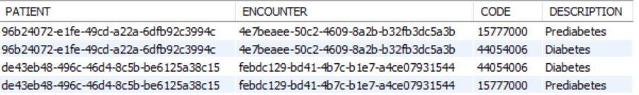
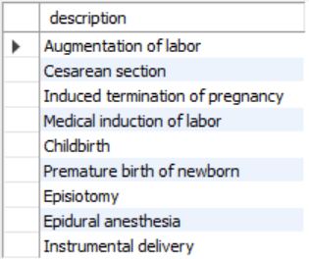
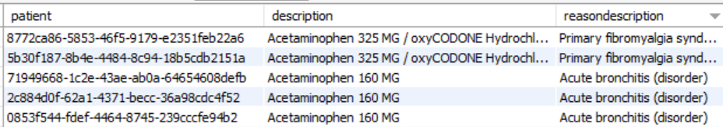
INSIGHTS FROM EXPLORATORY AND DESCRIPTIVE ANALYTICS
3. Retrieve all patients with Diabetes or Prediabetes?
4. What other procedures were done to patients with normal pregnancies excluding 'Standard pregnancy test’?
SELECT * FROM conditions WHERE conditions.description = "Diabetes" OR conditions.description = "Prediabetes";
SELECT DISTINCT procedures.description FROM procedures WHERE procedures.reasondescription = "Normal pregnancy" AND NOT procedures.description = "Standard pregnancy test";
5. Retrieve all patients who received Acetaminophen and the reason description?
SELECT * FROM conditions WHERE conditions.description = "Diabetes" OR conditions.description = "Prediabetes";
5

Slide 8
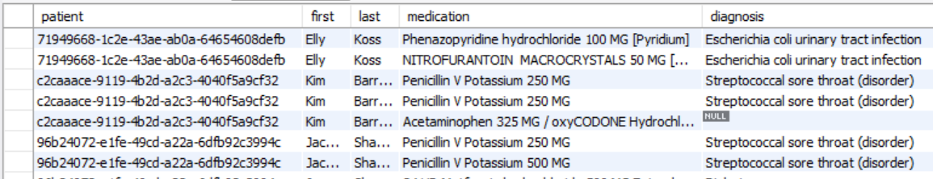
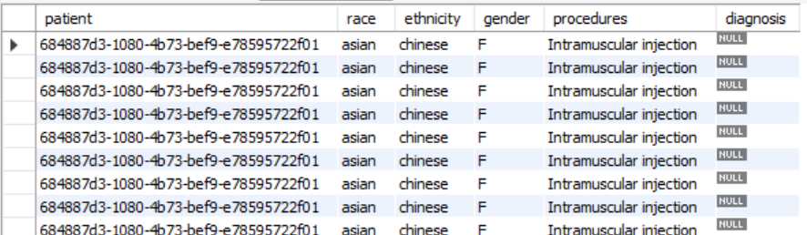
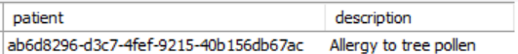
INSIGHTS FROM EXPLORATORY AND DESCRIPTIVE ANALYTICS
6. Link patients to their medications and diagnosis reasons?
7. Retrieve patient information along with associated procedure details for Asian female patients only?
SELECT patients.patient, patients.first, patients.last, medications.description AS medication, medications.reasondescription AS diagnosis FROM patients
JOIN medications ON medications.patient = patients.patient;
SELECT patients.patient, patients.race, patients.ethnicity, patients.gender, procedures.description AS procedures, procedures.reasondescription AS diagnosis FROM patients LEFT OUTER JOIN procedures ON patients.patient = procedures.patient WHERE patients.race = "asian" AND patients.gender = "F";
8. How many patients are allergic to mould, grass pollen, tree and house dust mite?
SELECT allergies.patient, allergies.description FROM allergies WHERE allergies.description IN ("Allergy to mould", "Allergy to grass pollen", "Allergy to tree pollen", "House dust mite allergy");
6

Slide 9
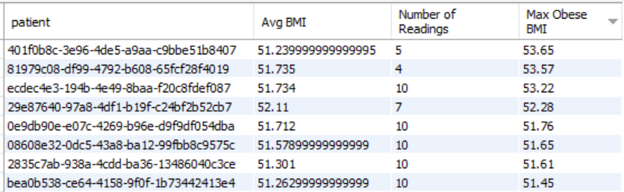
INSIGHTS FROM EXPLORATORY AND DESCRIPTIVE ANALYTICS
9. Calculate average BMI, number of (BMI) readings per patient, and the maximum BMI recorded that exceeds a threshold indicating obesity (BMI > 30)?
SELECT observations_cleaned.patient, AVG(CASE WHEN observations_cleaned.description = 'Body Mass Index' THEN observations_cleaned.value END) AS `Avg BMI`, COUNT(CASE WHEN observations_cleaned.description = 'Body Mass Index' THEN observations_cleaned.value END) AS `Number of Readings`, MAX(CASE WHEN observations_cleaned.description = 'Body Mass Index' AND observations_cleaned.value > 30 THEN observations_cleaned.value END) AS `Max Obese BMI`FROM observations_cleanedWHERE observations_cleaned.description = 'Body Mass Index'GROUP BY observations_cleaned.patient;
7

Slide 10
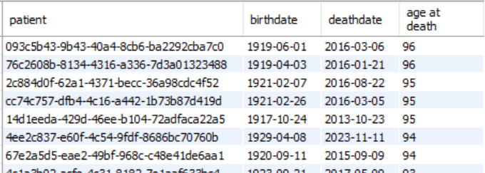
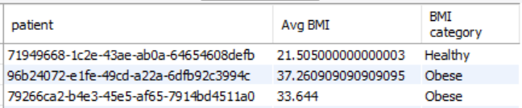
INSIGHTS FROM EXPLORATORY AND DESCRIPTIVE ANALYTICS
10. Categorize BMI values into different categories ('Underweight', 'Healthy', 'Overweight', 'Obese') for patients based on their BMI observations?
11.Calculate the age at death for patients who have a recorded death date?
SELECT patients.patient, patients.birthdate, patients.deathdate, TIMESTAMPDIFF(YEAR, patients.birthdate, patients.deathdate) AS `age at death`FROM patientsWHERE patients.deathdate IS NOT NULLORDER BY `age at death` DESC;
SELECT observations_cleaned.patient, AVG(observations_cleaned.value) AS `Avg BMI`, CASE WHEN observations_cleaned.value < 18.5 THEN 'Underweight' WHEN observations_cleaned.value >= 18.5 AND observations_cleaned.value < 25 THEN 'Healthy' WHEN observations_cleaned.value >= 25 AND observations_cleaned.value < 30 THEN 'Overweight' WHEN observations_cleaned.value >= 30 THEN 'Obese' END AS `BMI category`FROM observations_cleanedWHERE observations_cleaned.description = 'Body Mass Index'
8

Slide 11
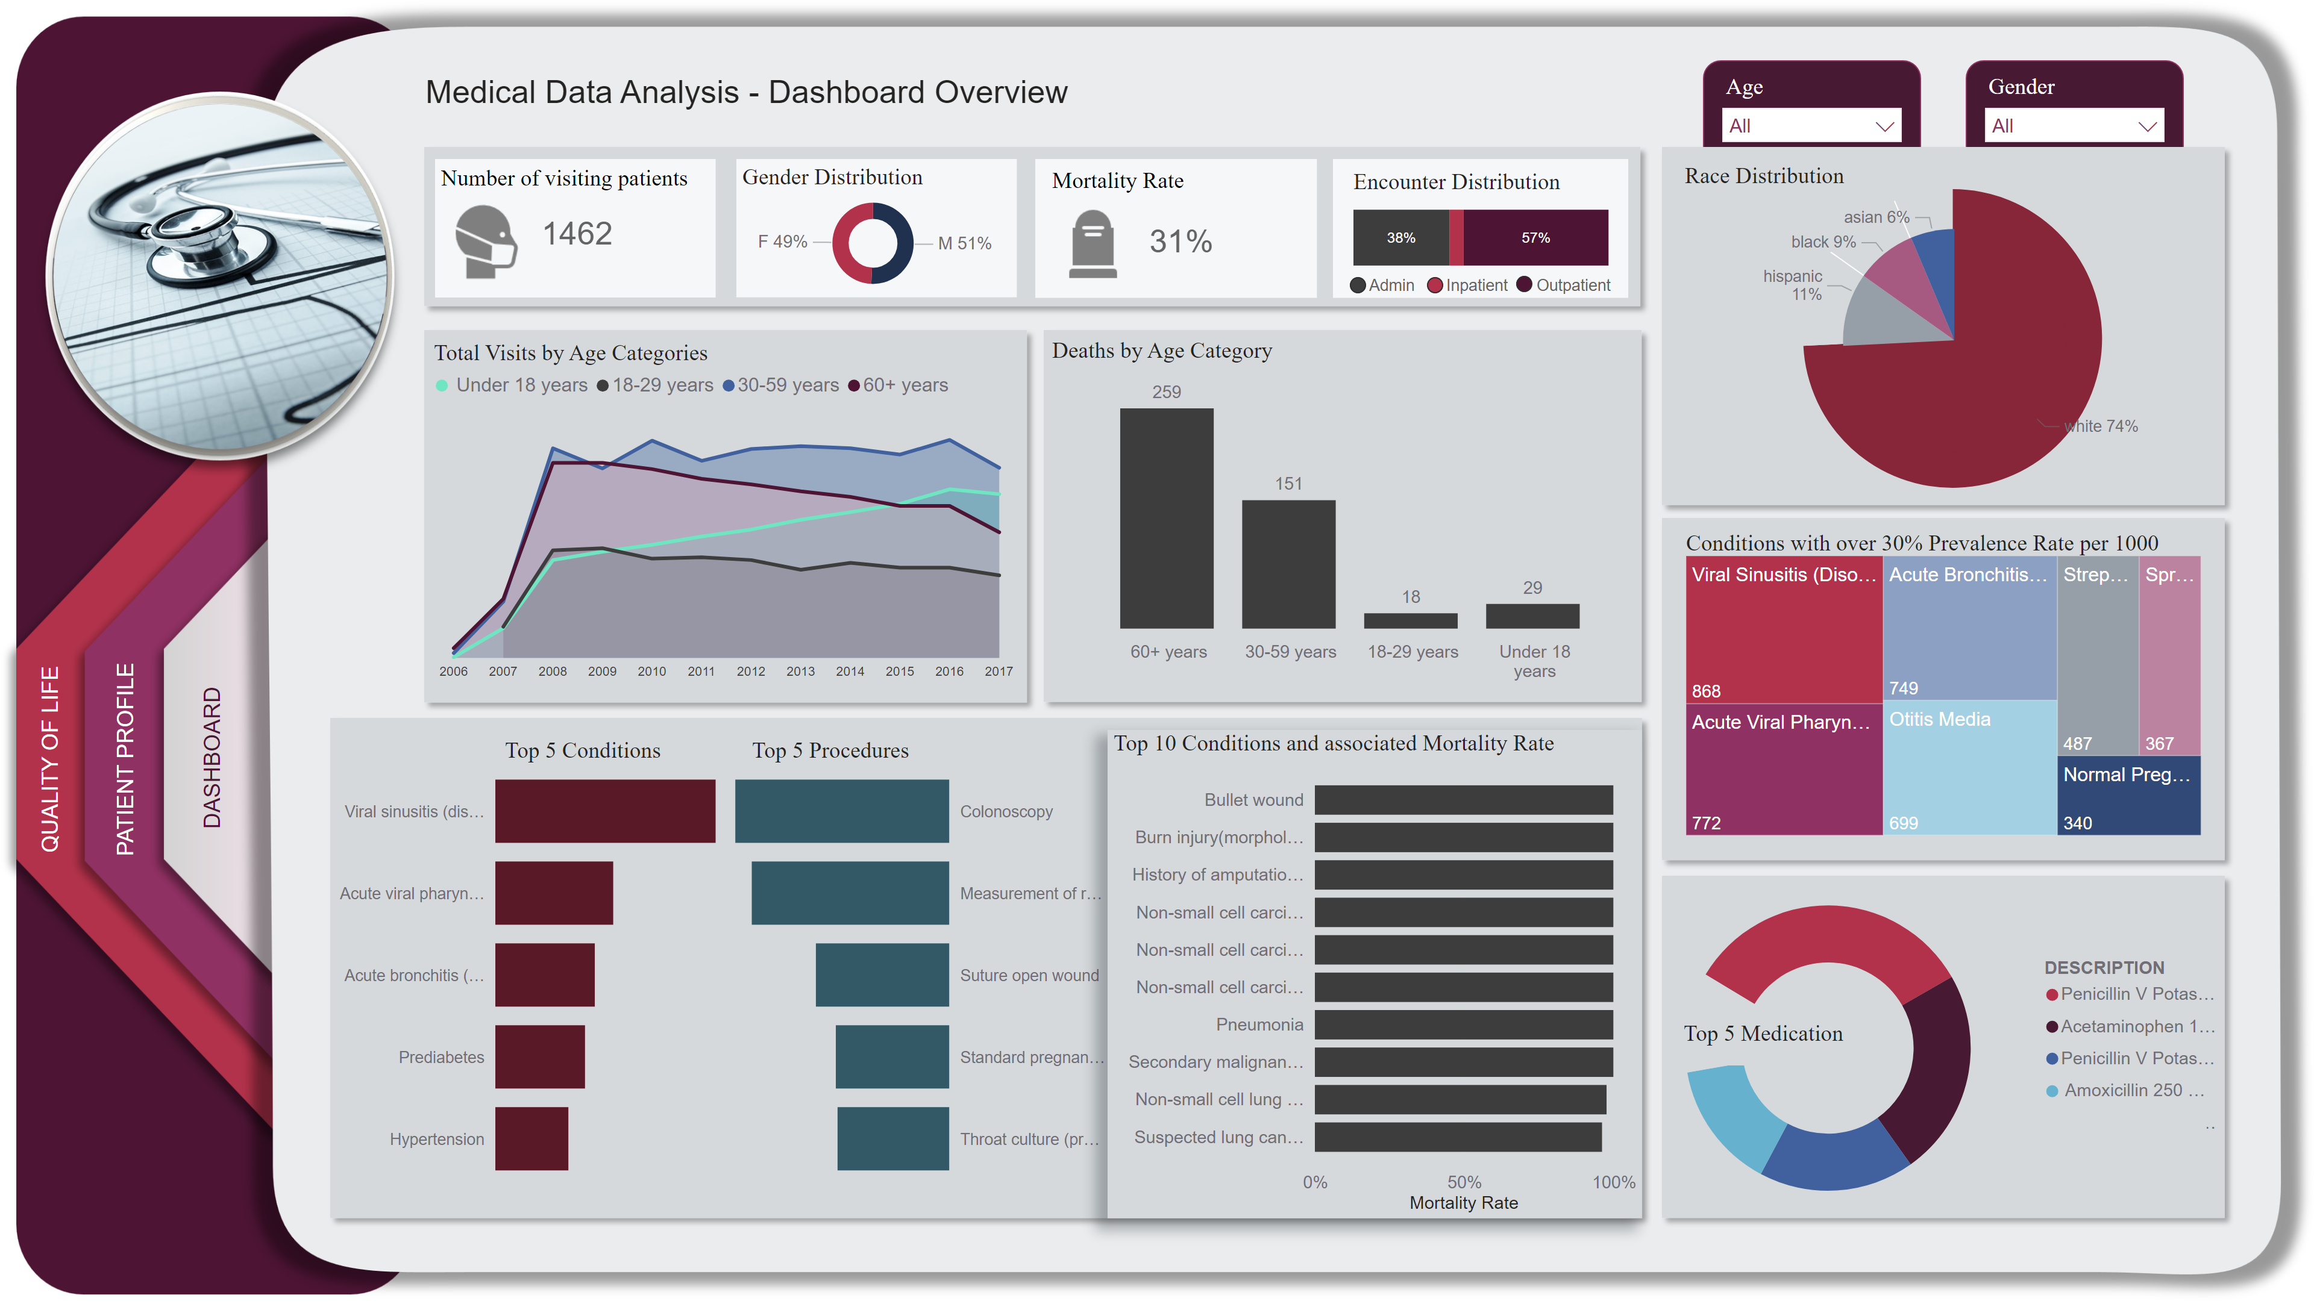

Dashboard
9
Notes:
actionButton
No alt text provided
actionButton
No alt text provided
actionButton
No alt text provided
Effectiveness of Medication
No alt text provided
Total Visits by Age Categories
No alt text provided
textbox
No alt text provided
image
No alt text provided
Number of visiting patients
No alt text provided
shape
No alt text provided
shape
No alt text provided
shape
No alt text provided
shape
No alt text provided
shape
No alt text provided
Encounter Distribution
No alt text provided
textbox
No alt text provided
textbox
No alt text provided
textbox
No alt text provided
textbox
No alt text provided
shape
No alt text provided
shape
No alt text provided
shape
No alt text provided
shape
No alt text provided
Preva-shape
No alt text provided
shape
No alt text provided
Conditions with over 30% Prevalence Rate per 1000
No alt text provided
shape
No alt text provided
shape
No alt text provided
shape
No alt text provided
Deaths by Age Category
No alt text provided
Top 5 Conditions
No alt text provided
Top 5 Procedures
No alt text provided
donutChart
No alt text provided
textbox
No alt text provided
textbox
No alt text provided
Mortality Rate
No alt text provided
image
No alt text provided
textbox
No alt text provided
textbox
No alt text provided
slicer
No alt text provided
slicer
No alt text provided
textbox
No alt text provided
Race Distribution
No alt text provided
Race Distribution
No alt text provided
textbox
No alt text provided
Top 10 Conditions and associated Mortality Rate
No alt text provided

Slide 12
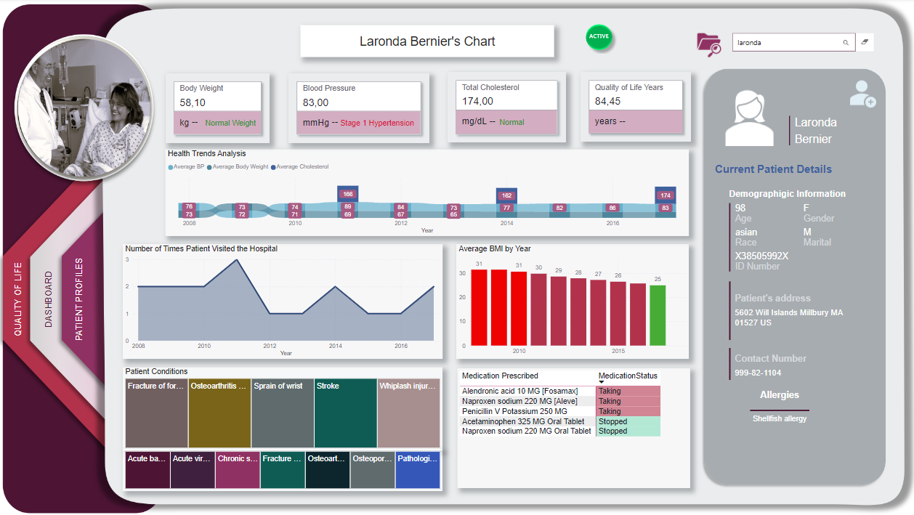
Dashboard
10
Notes:
actionButton
No alt text provided
actionButton
No alt text provided
actionButton
No alt text provided
Effectiveness of Medication
No alt text provided
Total Visits by Age Categories
No alt text provided
textbox
No alt text provided
image
No alt text provided
Number of visiting patients
No alt text provided
shape
No alt text provided
shape
No alt text provided
shape
No alt text provided
shape
No alt text provided
shape
No alt text provided
Encounter Distribution
No alt text provided
textbox
No alt text provided
textbox
No alt text provided
textbox
No alt text provided
textbox
No alt text provided
shape
No alt text provided
shape
No alt text provided
shape
No alt text provided
shape
No alt text provided
Preva-shape
No alt text provided
shape
No alt text provided
Conditions with over 30% Prevalence Rate per 1000
No alt text provided
shape
No alt text provided
shape
No alt text provided
shape
No alt text provided
Deaths by Age Category
No alt text provided
Top 5 Conditions
No alt text provided
Top 5 Procedures
No alt text provided
donutChart
No alt text provided
textbox
No alt text provided
textbox
No alt text provided
Mortality Rate
No alt text provided
image
No alt text provided
textbox
No alt text provided
textbox
No alt text provided
slicer
No alt text provided
slicer
No alt text provided
textbox
No alt text provided
Race Distribution
No alt text provided
Race Distribution
No alt text provided
textbox
No alt text provided
Top 10 Conditions and associated Mortality Rate
No alt text provided

Slide 13
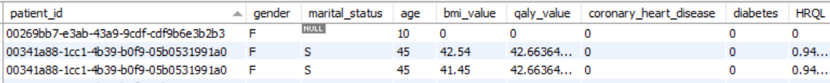
QUALITY OF LIFE MODEL PREDICTION
CREATION OF SUB-DATASET
SELECT patient_id, gender, marital_status, age, bmi_value, qaly_value, coronary_heart_disease, diabetes,
CASE WHEN age <> 0 THEN qaly_value / age ELSE NULL -- Handle division by zero if age is zero END AS HRQLFROM ( SELECT p.patient AS patient_id, p.gender AS gender, p.marital AS marital_status, TIMESTAMPDIFF(YEAR, p.birthdate, LEAST('2017-12-31', COALESCE(p.deathdate, '2017-12-31'))) AS age, COALESCE(o1.value, 0) AS bmi_value, COALESCE(o2.value, 0) AS qaly_value, CASE WHEN c1.description = 'Coronary Heart Disease' THEN 1 ELSE 0 END AS coronary_heart_disease, CASE WHEN c2.description = 'Diabetes' THEN 1 ELSE 0 END AS diabetes FROM patients p LEFT JOIN observations o1 ON p.patient = o1.patient AND o1.description = 'Body Mass Index' LEFT JOIN observations o2 ON p.patient = o2.patient AND o2.description = 'Quality adjusted life years' LEFT JOIN conditions c1 ON p.patient = c1.patient AND c1.description = 'Coronary Heart Disease' LEFT JOIN conditions c2 ON p.patient = c2.patient AND c2.description = 'Diabetes' WHERE o1.description IS NOT NULL OR o2.description IS NOT NULL OR c1.description IS NOT NULL OR c2.description IS NOT NULL ) AS summary_table;
11

Slide 14

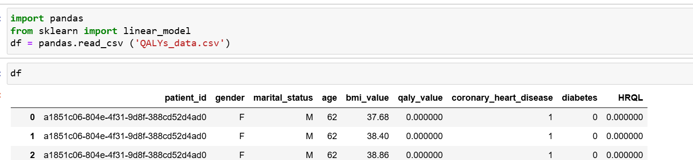
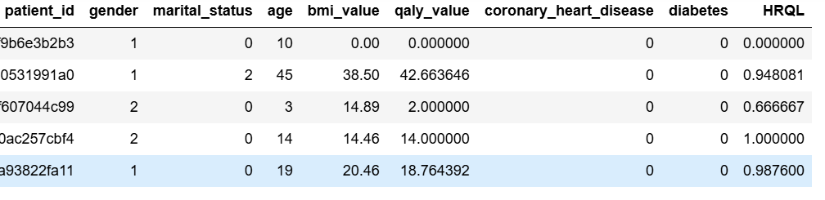
INSIGHTS FROM PREDICTIVE AND PRESCRIPTIVE ANALYTICS
# import data
import pandas
from sklearn import linear_model
df = pandas.read_csv ('QALYs_data.csv’) df
#drop duplicates
df.sort_values(by='patient_id', ascending=True, inplace=True)
df.drop_duplicates(subset='patient_id', keep='last', inplace=True)
#convert categorical values to numeric representation
df['gender'] = df['gender'].astype('category')
df['gender'] = df['gender'].cat.codes + 1
#Female is 1 and Male is 2
df['marital_status'] = df['marital_status'].astype('category')
df['marital_status'] = df['marital_status'].cat.codes + 1
#Single is 1 and Married is 2
#fill NULLs with 0
df['HRQL'] = df['HRQL'].fillna(0)
df.isnull().sum()
12

Slide 15
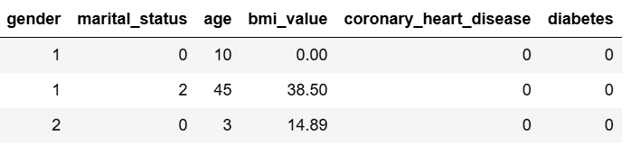
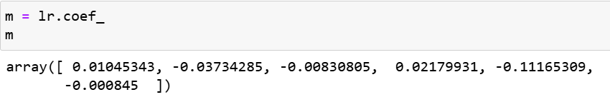
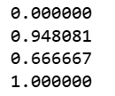
INSIGHTS FROM PREDICTIVE AND PRESCRIPTIVE ANALYTICS
#ready for modelling - predicting HRQL with several training features
columns_to_drop = ['patient_id', 'HRQL','qaly_value']
X = df.drop(columns=columns_to_drop)
X
#split dataset for training and testing
from sklearn.model_selection import train_test_split
X_train, X_test, y_train, y_test = train_test_split(X, y, test_size = 0.3, random_state = 0)
from sklearn.linear_model import LinearRegression
lr = LinearRegression()
lr.fit(X_train, y_train)
#Our label is HRQL
y = df['HRQL']
y
13

Slide 16
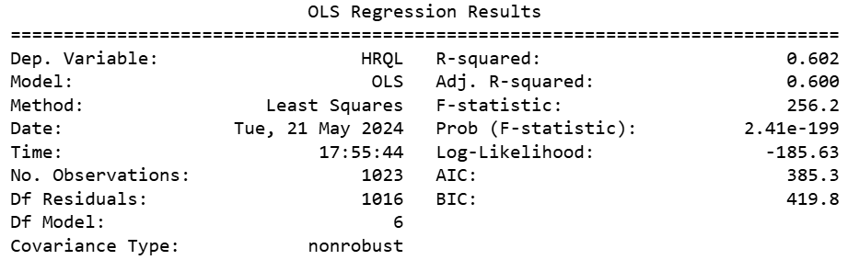
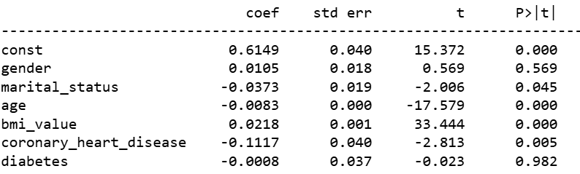
INSIGHTS FROM PREDICTIVE AND PRESCRIPTIVE ANALYTICS
#get tools for OLS regression analysis
pip install statsmodels
import pandas as pd
from sklearn.model_selection import train_test_split
import statsmodels.api as sm
import matplotlib.pyplot as plt
# Initialize and fit the OLS model using statsmodels
ols_model = sm.OLS(y_train, X_train).fit()
# Make predictions on test data
y_pred_test = ols_model.predict(X_test)
# Print the summary to check for significance of the coefficients
print(ols_model.summary())
# Visualize the predicted vs. actual HRQL using scatter plot
plt.scatter(y_test, y_pred_test)
plt.xlabel("Actual HRQL")
plt.ylabel("Predicted HRQL")
plt.title("Linear Regression: Actual vs. Predicted HRQL")
plt.show()
14

Slide 17
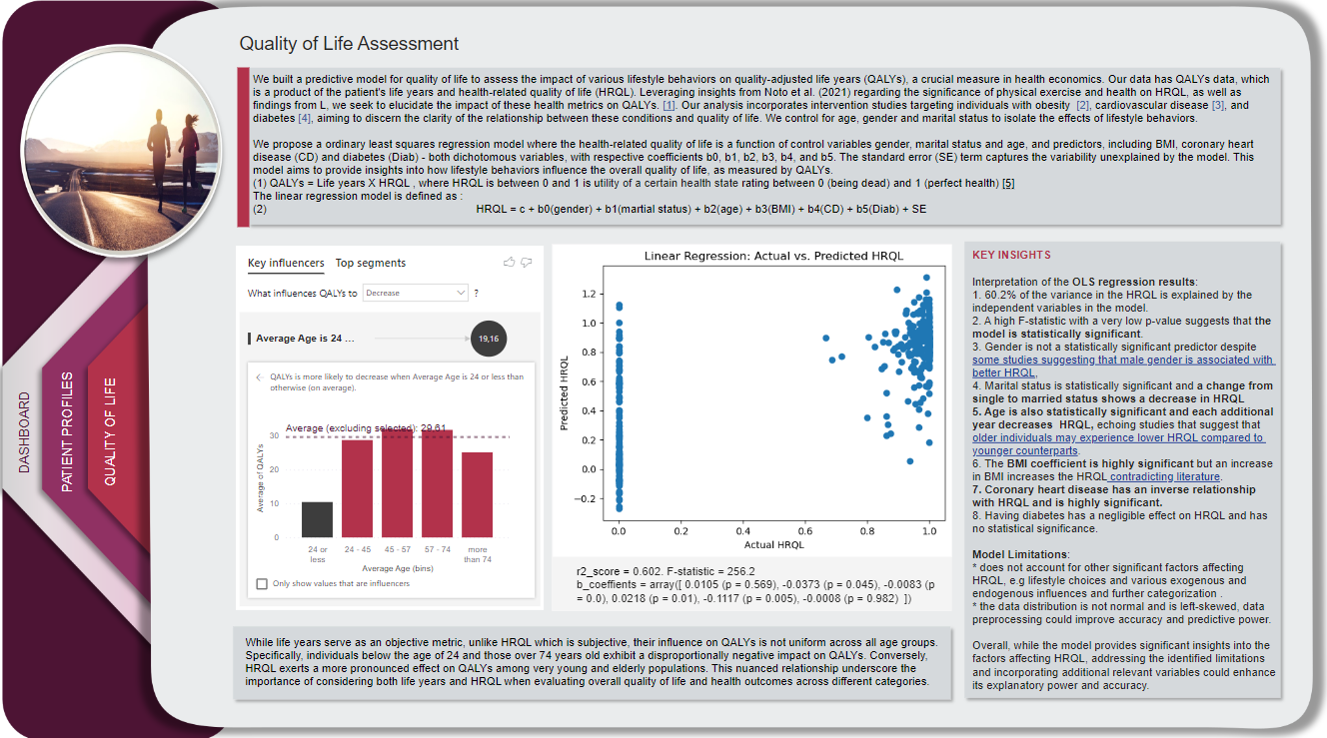
Dashboard
15
Notes:
actionButton
No alt text provided
actionButton
No alt text provided
actionButton
No alt text provided
Effectiveness of Medication
No alt text provided
Total Visits by Age Categories
No alt text provided
textbox
No alt text provided
image
No alt text provided
Number of visiting patients
No alt text provided
shape
No alt text provided
shape
No alt text provided
shape
No alt text provided
shape
No alt text provided
shape
No alt text provided
Encounter Distribution
No alt text provided
textbox
No alt text provided
textbox
No alt text provided
textbox
No alt text provided
textbox
No alt text provided
shape
No alt text provided
shape
No alt text provided
shape
No alt text provided
shape
No alt text provided
Preva-shape
No alt text provided
shape
No alt text provided
Conditions with over 30% Prevalence Rate per 1000
No alt text provided
shape
No alt text provided
shape
No alt text provided
shape
No alt text provided
Deaths by Age Category
No alt text provided
Top 5 Conditions
No alt text provided
Top 5 Procedures
No alt text provided
donutChart
No alt text provided
textbox
No alt text provided
textbox
No alt text provided
Mortality Rate
No alt text provided
image
No alt text provided
textbox
No alt text provided
textbox
No alt text provided
slicer
No alt text provided
slicer
No alt text provided
textbox
No alt text provided
Race Distribution
No alt text provided
Race Distribution
No alt text provided
textbox
No alt text provided
Top 10 Conditions and associated Mortality Rate
No alt text provided

Slide 18

RECOMMEDATIONS AND APPLICATIONS
Outcomes from this study can be summarized with the following
IMPACT OF LIFESTYLE BEHAVIOURS ON QUALITY OF LIFE
CLINICAL DECISION SUPPORT
HEALTHCARE RESOURCE ALLOCATION
PATIENT-CENTERED CARE
RESEARCH AND POLICY IMPLICATIONS
Data provides insights to healthcare providers for better diagnosis, treatment planning, and patient management
Data informs resource allocation strategies based on prevalent conditions and patient needs.
Predicting factors influencing patient quality of life and provide actionable insights for enhanced patient care
Personalize care plans and interventions based on individual patient profiles and risk factors.
Contribute to medical research and health policy decisions by highlighting key healthcare trends and challenges
16

Slide 19
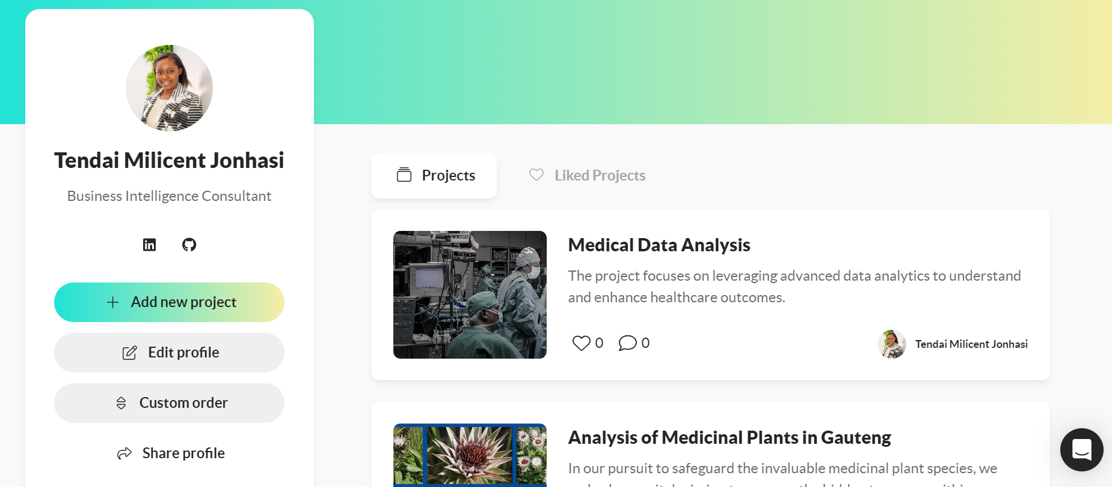



CHECK OUT the rest of MY PORTFOLIO!
Interact with Power BI Dashboards on my Maven Analytics Portfolio page
https://mavenanalytics.io/profile/Tendai%20Milicent-Jonhasi/199912327
.
17

Slide 20





TENDAI MILICENT JONHASI
tendaimjonhasi@gmail.com
https://www.linkedin.com/in/tendai-milicent-jonhasi/
https://github.com/tendaimjay
https://mavenanalytics.io/profile/Tendai%20Milicent-Jonhasi/199912327

